Slide 1

Internal audit report
Quarter 1, FY 2023-24
HR and Payroll ,Order to Cash &
Information Technology General Controls
FLP Trading Private Ltd
Financial Year 2023-24

Slide 2

Mazars
Esplanade House,
29 Hazarimal Somani Marg
Fort, Mumbai-400001
Tel: +91 22 6158 6200; 6158 7200
www.mazars.com
28 March 2024
FLP Trading Pvt Ltd
102, Oracle Point, 1st Floor,
Guru Nanak Road,
Opposite Bandra Railway Station,
Bandra (West), Mumbai: 400 050
For the attention of the Board of Directors
Dear Sirs / Madam,
INTERNAL AUDIT REPORT OF FLP TRADING PRIVATE LIMITED | YEAR 2023-24
Order to Cash, HR and Payroll and Information Technology General Controls
Following the completion of the internal audit of FLP Trading Pvt. Ltd, for the “Order to Cash, HR and Payroll and Information Technology General Controls” areas, we are now pleased to forward the final internal audit report for the above process. The ATR or Action taken report for the observations reported previously, is separately attached to this report as an excel sheet.
We thank the auditees as also the management team for enabling the internal audit.
Yours sincerely
Authorised signatory
MSME – UDHYAM-MH-19-0145164

Slide 3

Contents
01 DISTRIBUTION LIST 4
02 ABBREVIATIONS 6
03 COMPANY BACKGROUND 8
04 SCOPE 10
05 EXECUTIVE SUMMARY 17
06 DETAILED OBSERVATIONS, ANNEXURES & ATR 19
07 RATING CATEGORISATION, ROOT CAUSE & CAVEATS 58
April to June 2023
3

Slide 4
Distribution list

Slide 5
Distribution List
Review Scope
5
Mr. Darshan Sharma, Director and General Manager & Head of Logistics
Mr. Jayesh Koli, Director
Audit Coverage:
HR and Payroll : July 2022 to June 2023
Order to Cash : October 2022 to June 2023
ITGC : April 2023 to June 2023
Audit Objective As per the defined scope for the Company, the objective of the audit is to assess the adequacy of internal controls and to ensure the effectiveness and efficiency of the processes audited.
Key Dates for the Audit
Audit start date [Various dates between] | 10th October 2023
Audit end date | 05th January 2024
Queries issued | 09th January 2024
Draft report issued [various dates between] | 09th January 2024
Management responses received until | 02nd April 2024
Final report issued | 02nd April 2024
April to June 2023
5

Slide 6
02
Section 02:
Abbreviations

Slide 7
Abbreviations
Abbreviation | Full form
ATR | Action Taken Report
BoD | Board of Directors
BM | Board Meeting
BP | Best Practices
BR | Board Resolution
CIN | Corporate Identification Number
Cont'd | Continued
COVID-19 | Coronavirus Disease
CC | Case Credit
CMS | Cash Management Services
DSS | Daily Sales Summary
ERP | Enterprise Resource Planning
Etc. | Et cetera
FBO | Food Business Operator
FLII | Forever Living Imports India
FLPI | Forever Living Products (India) Private Limited
FLPT | FLP Trading Private Limited
Abbreviation | Full form
FY | Financial Year
GM | General Manager
HO | Head Office
HOD | Head of Department
HR | Human Resource
IT | Information Technology
MIS | Management Information System
NDP | New Distribution Price
P. A. | Per Annum
PE | People Issue
POS | Point of Sales
PR | Process Issue
RDO | Regional Distribution Office
SLA | Service Level Agreements
TDS | Tax Deducted at Source
UPI | Unified Payments Interface
WHP | Wholesale Price
7
April to June 2023
7

Slide 8
03
Section 03:
Company Background

Slide 9
Company Background
9
FLP Trading Private Limited (hereafter referred as “FLPT” or “the Company”) has been appointed as the designated distributor of Forever Living Imports (India) Private Limited (hereafter referred as “FLII”) for selling its products viz. Health, Nutritional and beauty products vide the ‘Purchase and Supply agreement and ‘Trade & Marketing Sub-license agreement’ both dated 6 September 2019.
The Company was incorporated on 17 March 2018 and has 21 RDOs across 17 states and 1 union territory of India, 6 warehouse (Bhiwandi, Delhi(Mundka), Indore, Jaipur, Bangalore & Lucknow) and a Head Office as on June 2023. All products are procured by the Company from FLII. Purchases are made from Bhiwandi location of FLII to respective locations of FLPT. Also, Branch / stock transfer take place between FLPT locations.
The Company had dealt in approximately 70 products & 63 literature items till June 2023.
April to June 2023
9

Slide 10
04
Section 04:
Audit Scope

Slide 11
Detailed scope for Human resources and Payroll
Sr. No. | Particulars
1 | Review of HR policies and procedures
2 | Review of agreements executed with HR placement agencies
3 | Manpower budget planning
4 | Recruitment and selection process
5 | Review of background verification process
6 | Employee files
7 | Employee master
8 | Training and induction
9 | Attendance and leave
10 | Payroll processing
11 | Bank pay outs
12 | Performance appraisal process
13 | Statutory payments
14 | Contract/ Labour law compliances
15 | Overtime
16 | Insurance
17 | Employee loan
18 | Full and Final settlement & Exit interviews
19 | Reimbursements
11
April to June 2023
11

Slide 12
Detailed scope for Order to Cash
Sr. No. | Particulars
1 | Price List
2 | Receipt of sales orders and timely processing;
3 | Completeness and accuracy of sales order forms
4 | Confirmation on receipt of sales proceeds
5 | Sales reporting
6 | Delivery planning and execution
7 | Invoicing
8 | Review of sales receivables along with ageing and strategy to reduce them
9 | Rejections, sales returns and credit notes
12
Action Taken Report (ATR) for the above scope will be presented separately.
April to June 2023
12

Slide 13
Information Technology General Controls
Sr. No. | Particulars
1 | IT Policies and Procedures
2 | Review of access rights
3 | Allocation of access rights
4 | Allotment and creation of user IDs
5 | Data security password policy
6 | Password tracker & antivirus license
7 | Data backup & policy
8 | Backup schedule
9 | Review of document for Disaster Recovery Planning (DRP) / Business Continuity Planning (BCP)
10 | Physical security at HO/ RDO
Action Taken Report (ATR) for the above scope will be presented separately.
April to June 2023
13

Slide 14
05
Section 05:
Executive Summary

Slide 15
Executive Summary-
Summary of Audit observations categorised as ‘IMPORTANT’
PR
PE
IT
BP
Slide | Observation | Root Cause
PR
Process issue
Root Cause - Legend
PE
People issue
IT
IT Issue
BP
Best Practices
April to June 2023
15

Slide 16
06
Section 06:
Detailed observations & Annexures

Slide 17
1. Human Resource and Payroll
17
Recruitment, separation and employee record maintenance
The Company has 81 employees as on 30th June 2023.
During the audit period, there were 3 employees who had resigned from employment. There were 6 employees who had joined the Company.
The Company has executed an agreement with 4 placement agencies (tabulated below) for the recruitment of employees.
The Company has advanced loans to 8 employees during the audit period.
Recruitment, separation and employee record maintenance
Salary payments are made online on a monthly basis. The bank advice form and the accounting voucher are approved by the Director prior to the disbursement of the monthly salary to the employees
Sr. No. | Placement Agencies | Sr. No. | Placement Agencies
1 | Vipany Management Consulting Pvt. Ltd | 3 | Sarvyasampana system solution Private Limited
2 | Perks HR Solutions | 4 | Salexi HR Advisory Private Limited
April to June 2023
17

Slide 18
1.1. Professional Tax
Process Issue
Moderate
18
Observation
Risk/Impact
Root Cause
Management Response
Professional Tax
On sample review of professional tax payments, we observed that there was a delay in payment for Patna, Guntur, Kerela & Shillong location amounting to Rs.0.12 lakhs. For details refer Annexure 1.1.1
PT Challan were not made available for verification.
Possibility of penalty under the PT Act of the respective states;
Delay in taking PT registration
Non monitoring of due dates.
Company should revalidate the compliance tracker with respective underline law.
Since the website was under maintenance at Guntur location, we were unable to make payment on due dates.
While taking the PT registration for Meghalaya location, officer has advised us to make the remittance on quarterly basis for Shillong location. We will make sure to pay before due dates.
For Kerala due date is 30th September 23.(As per Our consultant).
We will make sure to pay before due date of 30th November.
Later, PT challan were provided for verification.
Recommendations
RDO | PT challan period
Bangalore | July 2023 to September 2023
Timelines: Implemented
Responsibility: HR Department
April to June 2023
18

Slide 19
Annexure 1.1.1 : Delay in payment of professional tax
19
Location | Period | Due date | Payment date | Amount
Patna | FY-22-23 | 15th Nov 22 | 19-Jan-23 | 1,000
Patna | FY-23-24 | 15th Nov 23 | 8-Dec-23 | 3,000
Guntur | Nov 22 to Sept 23 | 10th of Next month | 30-Oct-23 | 4,000
Kerala | Apr 23 to Sept 23 | 31-Aug-23 | 27-Sept-23 | 3,500
Shillong | Jul 23 to Sept 23 | 28th of every month | 17-Oct-23 | 850
April to June 2023
19

Slide 20
1.2. Overtime provisions/ regulations
Process Issue
High
20
Observation
Risk/Impact
Root Cause
Management Response
Background
As per The Bombay Shops and Establishments Act, 1948, "The maximum limit for working overtime shall not exceed 3 hours per day and the employer may, for the purpose of the work beyond the said overtime hours, engage additional number of employees".
As per The Rajasthan Shops & Commercial Establishment Act, 1958 “The total number of overtime hours worked by an employee shall not exceed 50 hours in a quarter”.
As per The Bihar Shops & Establishment Act, 1953 “The total number of hours worked including the overtime, shall not exceed 12 hours a day”.
Observation:
On sample review of overtime, attendance & salary registers for the month of August 2023, we have noted hours have worked beyond the permissible threshold.
Non-compliance of the Act may lead to penal consequences and imprisonment implications to the person concerned.
Inadequate process for tracking the Overtime hours.
Absence of maximum overtime hours limit in the OT Policy.
Company to consider statutory limits as per all Acts while devising the OT Policy.
We always follow local Laws and Regulations. Due to some unavoidable situation staff had to work for few extra hours which was paid as per Overtime Rules. We will try to avoid such situation where Staff should not work for hours beyond his regular working hours.
Recommendations
Timelines: Dec 24
Responsibility: HR Department
April to June 2023
20

Slide 21
1.3. Practices in deviation with employee loan policy
Process Issue
Moderate
21
Observation
Risk/Impact
Root Cause
Management Response
Background:
Those employees who have more than one year of confirmed service with the company can apply for a loan.
A person who has already availed this facility shall not be entitled for another loan, before lapse of three month from the date of liquidation of old loan.
Observations: While reviewing the loan policy and current on-going practices, we observed the following:
In one instance (Employee-ID: FLPT0099), where another loan amounting to Rs.0.15 lakhs is provided to the employee before lapse of 'three' months from the date of liquidation of the old loan facility.
In one instance (Employee-ID: FLPT0099),despite of serving for less than 3 years, the tenure of loan offered is 10 months instead of 9 months.
Possibility of misuse of the employee loan facility by the employees.
Non monitoring of compliance with Employee Loan Policy.
Strengthen the process of monitoring Employee Loan.
The policy is monitored as per the norms, and it is meant for the employee welfare.
The request of some employees are considered under the Management discretionary powers accordingly the amount and repayment time limit is reviewed on case-to-case basis. The particular employee was transferred from Ahmedabad location to Ernakulam and to meet his related transfer expenses, the case was considered.
Served to company | No of instalments
Up to 3 years | 9 monthly instalments
More than 3 years | 12 monthly instalments
Recommendations
Timelines: Implemented
Responsibility: HR Department
April to June 2023
21

Slide 22
1.3. Practices in deviation with employee loan policy (Cont’d)
Process Issue
Moderate
22
Observation
Risk/Impact
Root Cause
Management Response
Background:
All the employee loan will be recovered in maximum 9/ 12 monthly installments from the month in which loan is loan is paid to the employee.
Observation: While reviewing the loan policy and current on-going practices, we found the loan recoveries were not made from the month in which loan were paid. Loan recoveries start from subsequent month from its disbursement or there was a delay of one month in such recoveries. ( Annexure 1.3.1)
Loss of equality in employee treatment.
Non monitoring of compliance with Employee Loan Policy.
Monitoring and strengthening the process relating to eligibility for loan.
Seeking appropriate approvals in case of deviations from policy.
Strengthening the recovery mechanism in case of default in repayment.
The Repayment period was considered as per approval of the Board of Directors
Recommendations
Timelines: NA
Responsibility: HR Department
April to June 2023
22

Slide 23
Annexure 1.3.1 : Deviation from loan policy w.r.t. Recovery of loan
23
Employee ID | Amount of loan ( in lakhs) | Loan disbursement date | Recovery start date as per policy | Actual loan recovery started from
FLPT0052 | 0.70 | 03-May-23 | 31-May-23 | 31-Jul-23
FLPT0037 | 0.99 | 16-Nov-22 | 30-Nov-22 | 31-Jan-23
FLPT0078 | 1.00 | 06-Mar-23 | 31-Mar-23 | 29-Apr-23
FLPT0008 | 1.00 | 22-Feb-23 | 28-Feb-23 | 31-Mar-23
FLPT0062 | 0.60 | 16-Nov-22 | 30-Nov-22 | 31-Jan-23
5 out of 13 Instances
April to June 2023
23

Slide 24
1.4. Display of abstracts of legal compliances
Process Issue
Moderate
24
Observation
Risk/Impact
Root Cause
Management Response
Background
Every Shop and commercial establishment shall notify calendar or list to the Inspector and specify in a notice prominently displayed in a conspicuous place in the shop or commercial establishment along with compliance with various Laws.
Observation:
During our visit to Corporate office at Mumbai, we observed display of abstracts of various Laws were not updated as stated below:
The Payment of Wages Act (Abstracts of June 2022)
Display of List of Holiday of workers in each shift
( Holiday list for 2022)
Penalty/ interest payment due to non-compliance with Shop and Establishment Act.
Absence of compliance checklist
Prepare the compliance checklist.
In regards to update, we have noted it.
Recommendations
Timelines: By 2024
Responsibility: HR Department
April to June 2023
24

Slide 25
1.5. Arrangements with manpower agency
Process Issue
Moderate
25
Observation
Risk/Impact
Root Cause
Management Response
Observation:
On the review of manpower recruitment agreements, we have come across that there is inconsistency in agreements in respect of professional fees charged, replacement period, invoicing period etc.
( Annexure 1.5.1)
It is based on negotiations and discussion between the agency which is accepted in writing by both the parties. Further, Charges are also depended on services provided by service provider.
Recommendations
Timelines: NA
Responsibility: HR Department
April to June 2023
25

Slide 26
Annexure 1.5.1 : Analysis of clauses as executed with respective manpower recruitment vendor
26
Sr. No. | Name of the Agency | Place | Professional Fees | Replacement period without extra cost | Invoicing period
1 | Perks Human Resource Solutions | Mumbai | 8.33% of annual CTC | 90 days | Within 30 days
2 | Salexi HR Advisory Pvt. Ltd. | Mumbai | 7.5 % of Annual CTC | 180 days | Within 45 days
3 | Sarvysampanna System Solutions Pvt. Ltd | Mumbai | 7.5 % of Annual CTC | 120 days | Within 30 days
4 | Vipany Management Consulting Pvt. Ltd | Hyderabad | Junior Level positions: 8.33% of Annual CTC Mid Level Positions: 10% of Annual CTC Leadership positions: 12.5% of Annual CTC | 90 days for junior & mid level positions 180 days for leadership positions | Within 30 days
April to June 2023
26

Slide 27
1.6 Employee Master
Process Issue
Moderate
27
Observation
Risk/Impact
Root Cause
Management Response
Background:
Company prepares employee master wherein all the details of employees are mentioned including the date of joining, date of confirmation, gross salary, TDS deduction, Allowances, Bonus, etc.
Observation:
On review of employee master, we have observed that there are the cases where date of joining dates as back as 3 or 4 years and date of confirmation is still not updated in employee master.
(Annexure 1.6.1)
Disbursement of loan without eligibility
Lack of review of Employee Master vis-a-vis employee confirmation letter.
Timely review of employee master with employee confirmation letter.
We will update the confirmation details.
Recommendations
Timelines: By 2024
Responsibility: HR Department
April to June 2023
27

Slide 28
Annexure 1.6.1 : Missing details w.r.t. of date of confirmation in employee master
28
Sr. No. | Employee ID | Location | Date of joining | Date of confirmation
1 | FLPT0088 | Jaipur | 24-Oct-19 | -
2 | FLPT0090 | Jaipur | 07-Nov-19 | -
3 | FLPT0095 | Corporate | 17-Nov-20 | -
4 | FLPT0097 | Corporate | 05-Dec-20 | -
5 | FLPT0098 | Corporate | 21-Dec-20 | -
5 out of 17 Instances
April to June 2023
28

Slide 29
1.7. Other Points
Process Issue
Low
29
Observation
Background:
As per overtime Policy of the company, overtime hours are the excess hours served after their normal working hours. Employees drawing a salary below Rs.35,000 will be eligible for Overtime. OT will be paid at 2 times the normal gross salary of the employee, calculated on hourly basis.
As per the OT Policy, All OT’s should be approved by the HOD/HR in advance or at the time of work.
An original OT slip should be sent to HR at HO before the 5th of following month.
OT will be paid only if the employees work for more than 9 hours on a normal day and 5 hours on a half day.
Observations:
OT slips were not made available for verification for the period covered under audit (July ‘22 to June ‘23).
On sample review of OT slip for the month of August 2023, in few instances, approval of HOD/ HR was not available. (Annexure 1.7.1)
OT slips are available and can be verified any time in person. OT slips are attached to your reports also.
OT slips are always approved before payment of Overtime. We agree that due to some challenges it could not be signed that time but we will make sure to avoid such error in future.
Management Response
April to June 2023
29

Slide 30
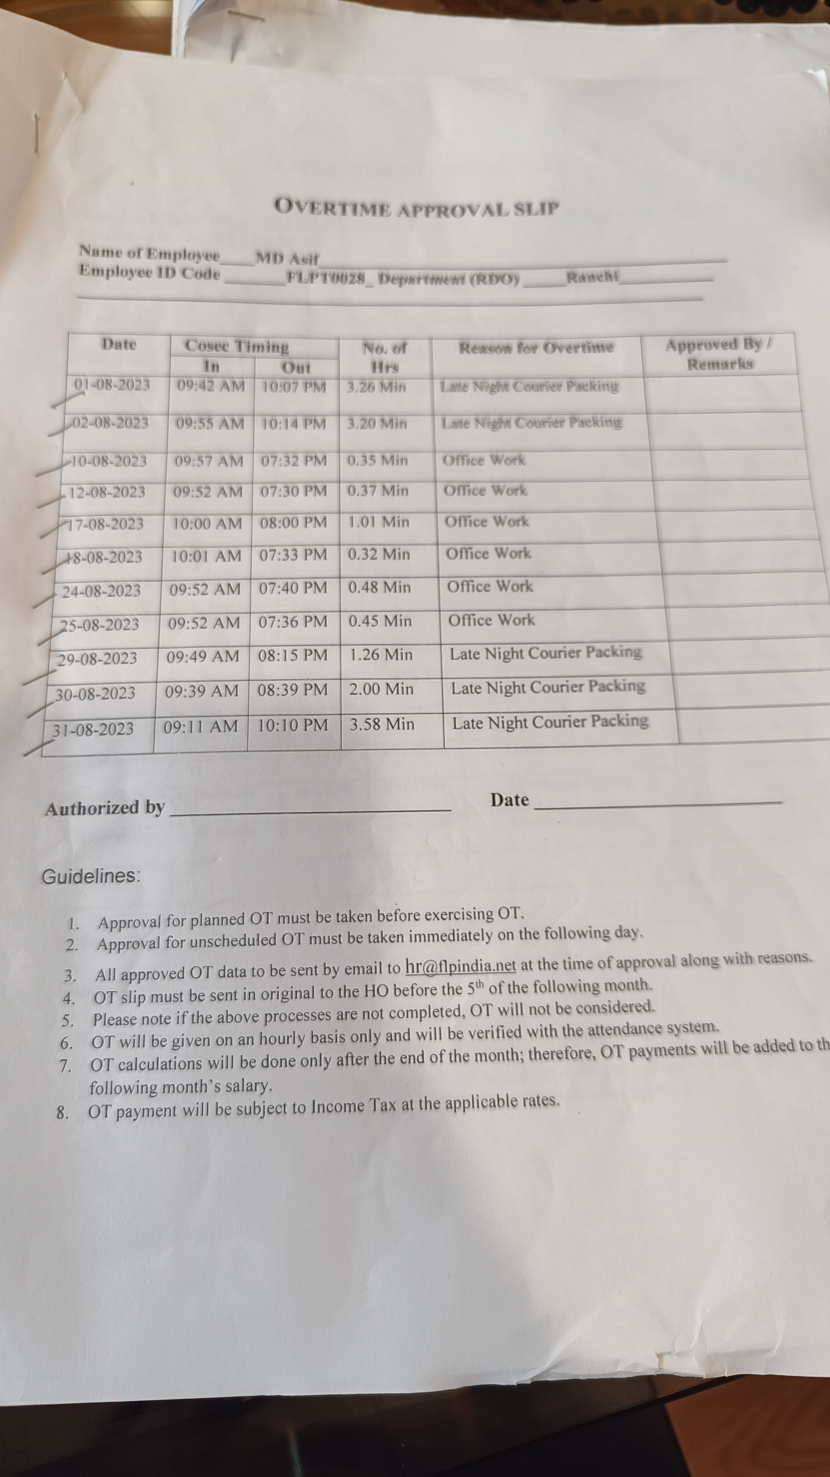
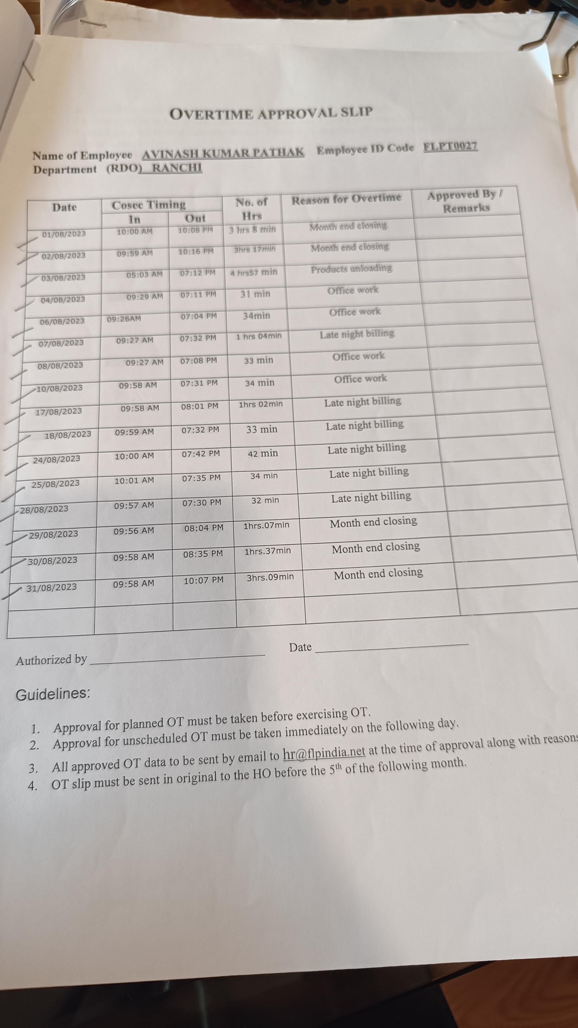
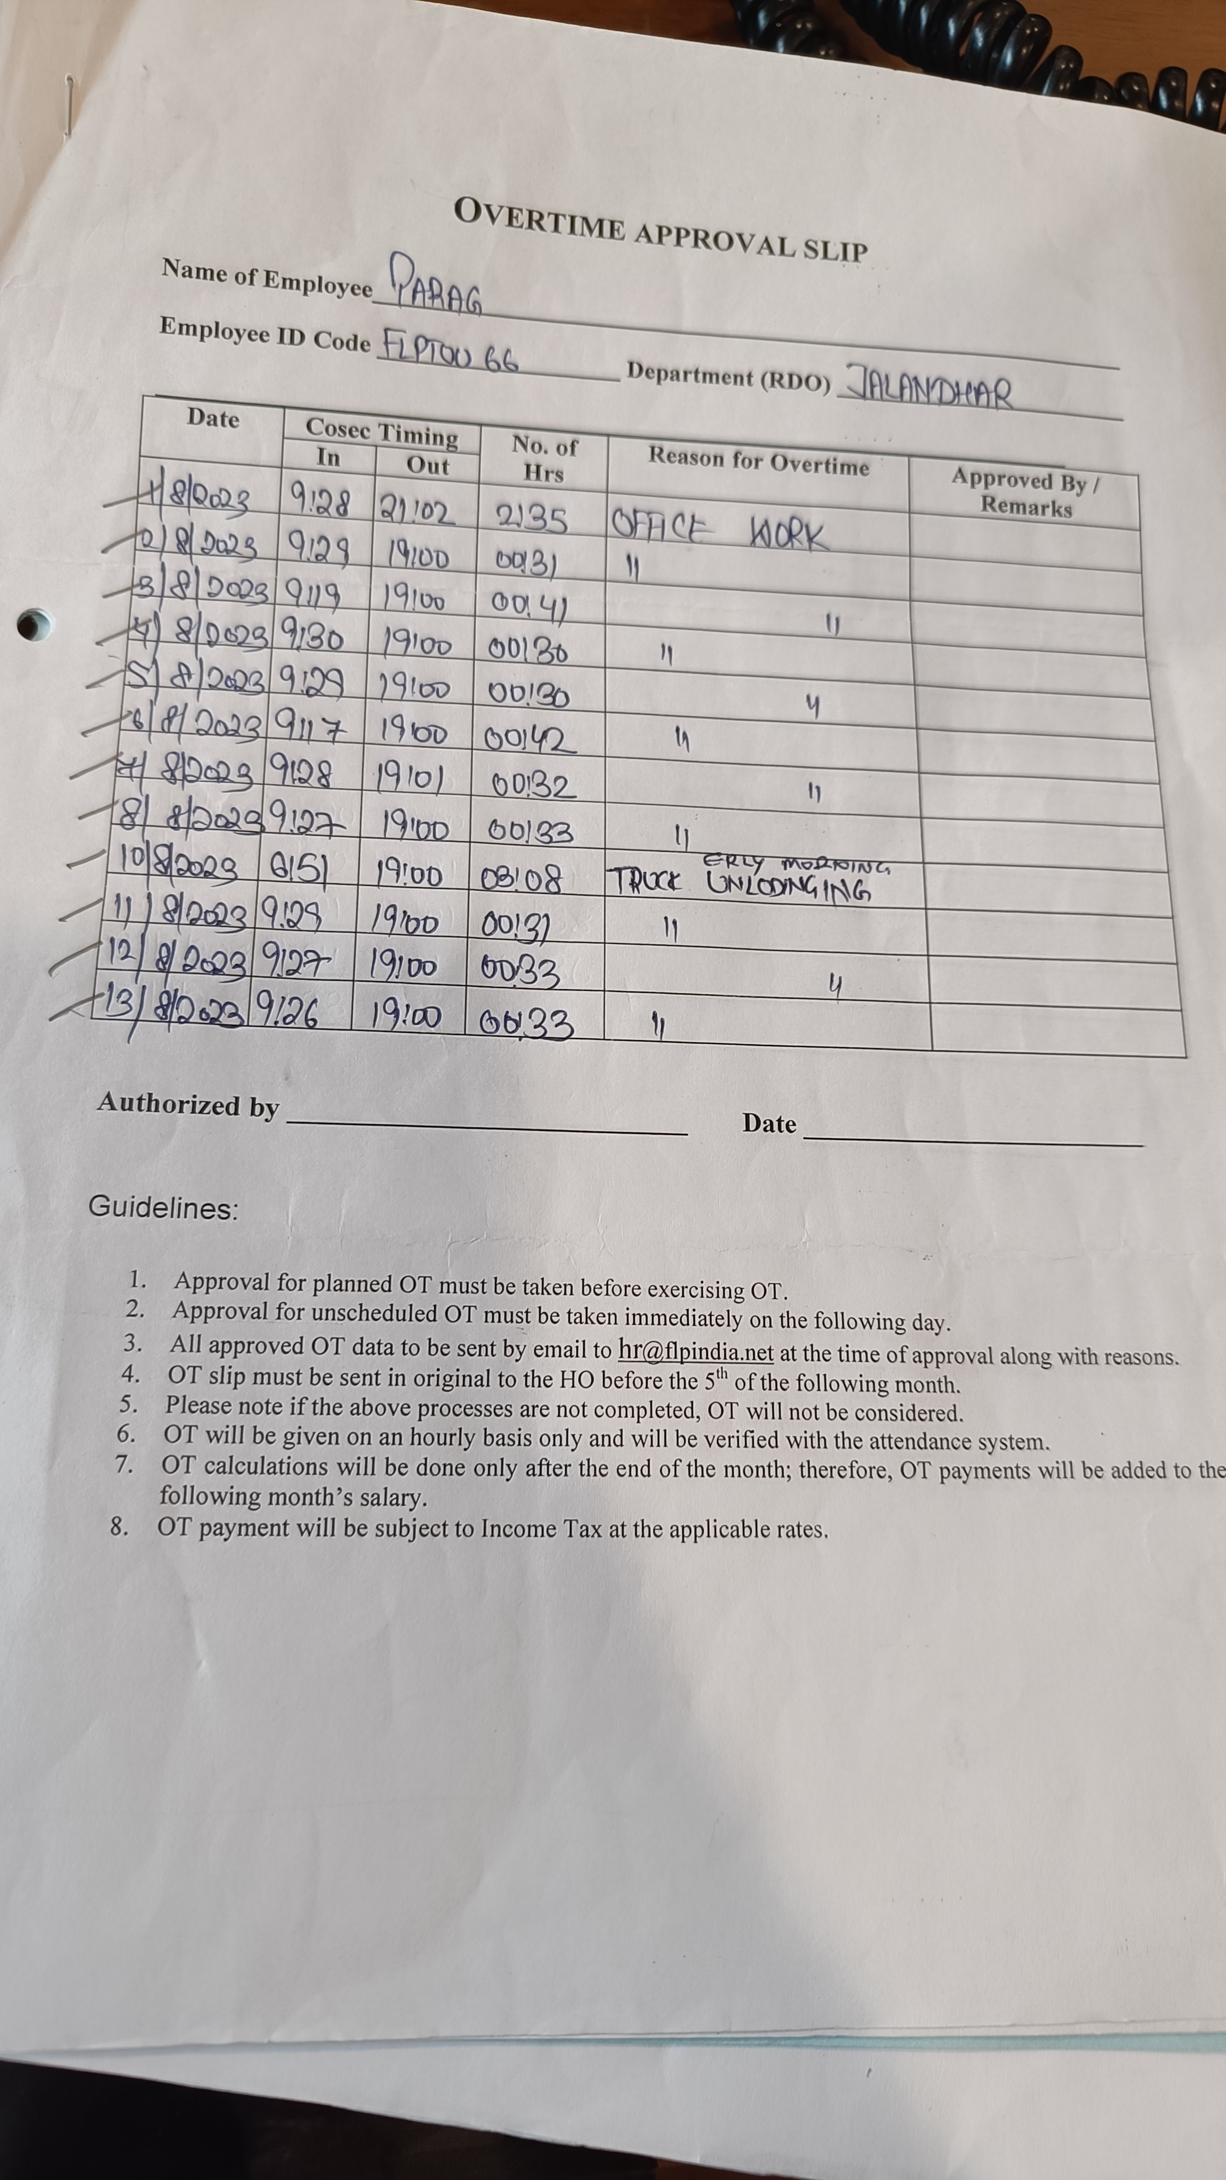
Annexure 1.7.1: Unauthorized OT Slip
April to June 2023
30

Slide 31
Follow up status of previous year IA reports
31
Compliance status of observations in audit reports relating to areas covered in the current scope of work for HR & Payroll area:
Particulars | High | Moderate | Low | Total
Observations for which actions are recommended | - | 4 | - | 4
Actions taken and verified | - | - | - | -
Actions Items in progress/ partially implemented / not applicable | - | 3 | - | 3
Actions Items Not implemented | - | 1 | - | 1
April to June 2023
31

Slide 32
3. Action Taken Report Not Implemented Observations
Area | Period | Brief Observation | Management Response
Observations categorized as ‘MODERATE’
HR & Payroll | April 2022 to June 2022 | Observations: We observed that the company does not have formally approved and documented policies on following area: Code of conduct; Organisation Structure; Manpower planning; Recruitment Policy (can include Manpower requisition form, background verification criteria, Standard list of documents to be collected, etc.); Vendor Empanelment Process (recruitment agency), selection criteria, background verification etc.; Exit Policy / Internal Group Transfer Policy (Resignation methods, Handover process, Exit interviews, Clearances etc.); Performance Appraisal Policy; Training Policy including induction training etc.; Whistleblower / Fraud policy. | We are in process of Documentation. Target Date – By 2023
April to June 2023
32

Slide 33
3. Action Taken Report (Cont’d) Partially Implemented Observations
Area | Period | Brief Observation | Management Response
Observations categorized as ‘MODERATE’
HR & Payroll | April 2022 to June 2022 | Observations: While review of loan policy and current on-going practice, we observe the following: Loan policy is not version controlled. Employee loan proposals of FY 21-22 were placed BoD for approval with the delay. Accounts department is processing the loans based on email information, and they does not verify the necessary approvals on application forms. HR Policy is completely silent about taking post dated cheques as security from employees. It has been observed that out of 8 loans disbursed, only in 2 instances, such cheques have been collected. | Currently we are not following process for version control because there are no frequent changes in the policy. Noted, we will adhere to timelines henceforth. The Policy upgradation is in process. The Policy upgradation is in process. Target Date : By 2023
HR & Payroll | April 2022 to June 2022 | In few instances, approval of HOD / HR not available Also, documentary evidence is not available to verify the Authority of matrix for HOD and HR approvals. Company does not have the Delegation of Authority matrix. | For all the positions, there is no similar or same hierarchy hence approval of HOD may not be available. In this instances final approvals given by Directors in physical form. Also, these loans are approved in BR hence; delegation of matrix is not required. Target Date : NA
HR & Payroll | April 2022 to June 2022 | On a review of process of resignation by employee, we observed that company does not have a process of taking formal Clearance Certificate from all the relevant departments like HOD, IT Department, HR department. Company does not have a process of taking confirmation for full and final settlement receipt.
April to June 2023
33

Slide 34
The respective FBO fills in the order form to purchase the intended products
The completed order form is submitted and verified by the cashier at the RDO
The cashier fills in the FBO ID details, mode of delivery, product details and payment details in the POS system
The Company provides counter and non-counter delivery facility to its FBOs
The following mode of payments facilities are given to the FBO:
-Cash,
Credit/ Debit Card;
-UPI and
-Direct Deposit
After the receipt of payment from the FBO, the sales invoice is generated and the “Payment Received” stamp is affixed by the cashier
In case of counter delivery, the respective FBO proceeds to the delivery counter to collect the invoiced products
In case of non-counter delivery, the sales invoice as generated is given to the stores executive for the dispatch of goods through courier
On receipt of sales invoice, the store executive delivers the products and updates the details in the system through bar code scanning
The store executive affixes “Delivered” stamp after all the products are issued to the respective party
The store executive updates the courier tracking delivery details in the system for future reference tracking
The cashier/ RDO head extracts and reconciles the summarized sales invoice and collection reports from the system
Order To Cash Function
34
April to June 2023
34

Slide 35
2. Order to Cash
a) Sales reporting
Data wrt day to day sale is captured in DSS report generated from ERP software at each RDO and is downloaded by the accounts executive at the corporate office (Mumbai). Based on the report, entries in the accounting records are processed on the next day.
Sales are made either at NDP or WHP. WHP is offered to FBOs who have crossed the condition of purchasing products valued at 2 CC or more within 2 consecutive calendar months.
Summarized sales during April to June 2023 is mentioned below ( Net Sales excluding deferred revenue).
(₹ in Lakhs)
Month | Amount
April 23 | 5,253.05
May 23 | 5,080.54
June 23 | 5,761.48
Total | 16,095.07
April to June 2023
35

Slide 36
2. Order to Cash (Cont’d)
b) Online sales (Aloe Store)
The Company has given an option to FBOs to purchase their products online through their website.(https://aloestoreindia.in/)
The FBO can purchase and receive the products at their desired locations through their registered login ID and password.
The order populates in the sales invoice report of the respective RDO. As explained, the POS system and Aloe store software are integrated.
c) Collection controls
The Company has executed the agreements with One97 Communication Limited (Paytm) on 21 May 2020 for the electronic receipt of considerations from their FBOs
The RDO head and cashier are responsible for the cash received on account of sales effected during the day.
At the day end the cash available and the credit card receipts are reconciled and matched with the daily consolidated system report. The cash is subsequently deposited in the cash vault/ bag which is kept in the custody of the RDO head.
The Company has executed a CMS agreement with Axis Bank Ltd on 10 May 2018 for the collection of cash receipts from the respective RDO locations
April to June 2023
36

Slide 37
2. Order to Cash (Cont’d)
Sub-areas audited under Order to Cash:-
a) Price List
Rate Master Analysis:-
Sr No | Particulars | Checklist | Status
1. | Product Code Analysis | Duplication in product code for different products | No such instance identified
2. | Product Name Analysis | Duplication in product name for different product code | No such instance identified
3. | Classification of WHP/NDP on the basis of CC | Whether the WHP/NDP price was appropriately classified on purchase of more than 2CC | All the FBO’s were correctly mapped with WHP/NDP price as applicable to them on the basis of CC.
4. | Revision in prices | Whether the revision in prices has been correctly marked on the products, after its date of revision | Revised prices have been correctly marked
April to June 2023
37

Slide 38
2. Order to Cash (Cont’d)
Sub-areas audited under Order to Cash:-
b) Invoice-wise Analysis
Checked with respect to Daily Sales Summary and GSTR-1 Summary:-
Sr No | Particulars | Checklist | Status
1. | Price Analysis | Mapping of Invoice amount from DSS and GSTR-1 Summary | No instances found of mismatch between DSS and GSTR-1
2. | Price Analysis | Mapping of Invoice amount from DSS and books of accounts | No instances found of mismatch between Sales as per Tally and GSTR-1
3. | Contents in Tax Invoice | Checking the provisions of contents of Tax Invoice as per GST Provisions | Provisions of GST Act has been duly complied
4. | Cash receipt against invoice | Mapping of cash receipt against sale with DSS. Whether the same is booked in Tally. | No instances found of mismatch between Cash as per Tally and DSS
5. | Advance Allocation Form(AAF) | Advance received from customer/FBO (direct deposit in the bank account) against the products. | Checked the contents filled in the AAF and corresponding deposit/credit in our bank account.
6. | Delivery Status | For the non-counter sales, delivery status is tracked via the tracking number and “delivered” stamp affixed on the invoice on delivery. | Samples verified for non counter sales.
April to June 2023
38

Slide 39
2. Order to Cash (Cont’d)
Sub-areas audited under Order to Cash:-
c) Receipt other than cash (via Credit/Debit cards, UPI and Net Banking channels)
Checked with respect to non-cash receipts:-
Sr No | Particulars | Checklist | Status
1. | PayTM Agreement | Rate of commission to be charged by PayTM for Credit/Debit cards and Net Banking channels | List of charges(Commissions) mentioned as per agreement entered with FLPT
2. | PayTM Settlement report | Whether the commissions have been appropriately computed and charged by PayTM for transactions other than cash and UPI. | No instance of mismatch was identified during the audit period.
3. | Entries in the books of accounts | On the basis of the daily PayTM settlement report, entries are booked in the books of accounts | No instances of mismatch or delay identified in recording the entries in the books of accounts.
4. | Delivery Charges/ Courier charges | Whether the delivery charges have been appropriately charged based on the CC limit | No instances of mismatch in charging of delivery charges
April to June 2023
39

Slide 40
2. Order to Cash (Cont’d)
Manual processes in the order to cash cycle
Process | Issue | Recommendation
Sales Reporting | Sales posting of daily sales register from ERP Software in the accounting records | Integration of accounting records to ERP Software
This recommendation has been reported in previous reports. However, it has not been acted upon till date.
April to June 2023
40

Slide 41
Unaddressed observations from earlier reports (High)
Area | Observations as per earlier reports | Action Recommended | Current Status | Revised Management response | Risk
System Controls | POS payment system: On review of the POS payment system, we observed the following: The cash till/ drawer was not auto locked and linked with the POS system; it should ideally open only if “cash” is chosen as the mode of tender; The credit card payment gateway was not linked with the POS system to auto update the amount and read and save only last 4 digits of the credit card. User Access controls We observed that the Company did not maintain restrictive access rights given based on their attendance and work timings to their POS users. | Explore the possibility of auto locking the cash till/ drawer and linking the details with the POS system. Link the credit card payment details with the POS and maintain security and confidentiality details (display of the last 4 digits of the credit card on the payment device etc.). Explore the possibility of allocating user rights for the POS system based on their attendance and the store timings. | Partially Implemented POS Payment System: Not implemented User Access Controls: Implemented | We have noted your suggestions, and we will explore the possibility of implementing the same. User Access controls: We have provided separate login for each RDO Staff, Whoever is available in RDO will use their login ID to login in POS.
April to June 2023
41

Slide 42
Follow up status of previous year IA reports
42
Compliance status of observations in audit reports relating to areas covered in the current scope of work for order to cash area:
Particulars | High | Moderate | Low | Total
Observations for which actions are recommended | - | - | - | -
Actions taken and verified | - | - | - | -
Actions Items in progress/ partially implemented / not applicable | - | - | - | -
Actions Items Not implemented | - | - | - | -
April to June 2023
42

Slide 43
3. Information Technology General Controls
The Company has a workgroup network. Individual login IDs are not created for employees. The email IDs of the employees are created once the IT department receives a written intimation from the HR department.
The Company’s server is located at the registered office at Oracle Point and data is also stored offsite i.e., at the Forever Living Products Plaza office.
The services provide by FLPI includes administration, finance, logistical and warehousing and IT activities.
Data backup for the working files and the accounting records data is taken daily which is subsequently overwritten after 7 days. An additional offsite backup is taken and stored at Plaza Office every Saturday / Sunday.
A physical verification of IT assets is carried out by the IT team once in every quarter (only for Mumbai location), but no report is being prepared for the same. For other locations IT assets are being physically verified along with the physical verification of non-IT assets.
April to June 2023
43

Slide 44
3. Information Technology General Controls (Cont’d)
With regards to the ITGC Area, on the basis of the audit conducted and documents checked in the audit period, we found:-
a) No change in the IT Policy of the company
b) No change in the IT Infrastructure of the company
c) No change in the IT Systems of the company
There were no markable/ considerable observation in this area, considering the review of this area was undertaken in Q4 for FY 2022-23. Thus, on the basis of the ATR given in the previous report, the following list of points are yet to be implemented. These shall be implemented by the company as per the timelines given herewith.
April to June 2023
44

Slide 45
Follow up status of previous year IA reports-Information technology General Controls
45
Particulars | High | Moderate | Low | Total
Observations for which actions are recommended | 7 | 2 | - | 9
Actions taken and verified | - | - | - | -
Actions Items in progress/ partially implemented/ not applicable | - | - | - | -
Actions Items Not implemented | 7 | 2 | - | 9
April to June 2023
45

Slide 46
3. Action Taken Report (Cont’d) Not Implemented Observations
Area | Period | Brief Observation | Management Response
Observations categorized as ‘HIGH’
ITGC | January 2023 to March 2023 | Absence of approval for active USB ports: While conducting the PV of IT Assets on 2 June 2023, at Oracle office location, we observed that in 3 PCs, USB ports were not blocked, and exception approval for the same was not on record. Absence of approval for data card usage: one of the employee from Ranchi location (Emp ID - FLPT0027) is using the data card, and exception approval for the same was not on record. | We have now restricted USB port usage for PENDRIVES to all employee except Laptop user to share large file to auditors. We have not restricted USB port usage for DATA card. For usage of data card approval is not required. We will revisit our IT policy to address the issue. Target Date: 31 December 2023
ITGC | January 2023 to March 2023 | Sharing of password: Login credentials of new ERP ID credentials (for employee FLP0111) was shared over the common email id of (Ernakulam) used by multiple employees. | FLPT0111 user is using generic email id, hence the password share the generic email ID. We will find some solution to share password to the user one to one, who is using generic email. Target Date : NA
Employee Code | Asset code
FLPT0050 | FLPT/COMH-60/MUM-O/21
FLPT0086 | FLPT/COMH-60/MUM-O/33
FLPT0040 | FLPT/COMH-60/MUM-O/7
April to June 2023
46

Slide 47
3. Action Taken Report (Cont’d) Not Implemented Observations
Area | Period | Brief Observation | Management Response
Observations categorized as ‘HIGH’
ITGC | January 2023 to March 2023 | CCTV recording back up: As informed, company does have a practice of keeping recordings for 15 days on a playback Mode and no separate backup maintained. Absence of register: As informed, IT team does not have practice of maintaining register about the cctv footage sharing. | We have record for past 15 days on Playback mode, which can be verified at respective RDO locations. We don’t share CCTV footage with anyone, in case of incident we call the requester on our desk and show the footage. Target Date: NA
ITGC | January 2023 to March 2023 | Absence of recovery test: As informed, IT team has not conducted any recovery tests for any of backups. | We will check on this with management as it required additional investment. Target Date: NA
ITGC | January 2023 to March 2023 | HR authorised email were not on record: During our review period, we had verified sample email for HR authorization for deleting email id for resigned employees. The same were not available for below mentioned instances. Exception approval was not on record: COO approval for keeping email id active for resigned employees were not provided: | For employee FLPT102, initially we had created individual email id for employee FLPT102, but as per management decision a generic email id was created. Email used by employee FLPT108, is deleted with the authorisation of Director (Mr. Darshan Sharma). For deletion of email id used by employee having code - FLPT0070, there was a verbal communication from Director (Jayesh) for keeping the mail id active for more then 30 Days, going forward we will keep on email. Target Date: NA
Employee Code
FLPT0102
FLPT0108
Employee Code | Resigned date | Email deletion date | Delay in days
FLPT0070 | 25 Nov 2022 | 06 April 2023 | 132
April to June 2023
47

Slide 48
3. Action Taken Report (Cont’d) Not Implemented Observations
Area | Period | Brief Observation | Management Response
Observations categorized as ‘HIGH’
ITGC | January 2023 to March 2023 | During our review, we observed that the company has not yet incorporated Business Continuity Plan (BCPs) and Disaster Recovery Plan (DRP). | We will discuss your recommendations with management. Target Date: NA
ITGC | January 2023 to March 2023 | Absence of Auto logoff features: While conducting the physical verification of IT Assets on 2 June 2023, at Oracle Office, we observed that in any of the desktops, screen controls like lock screen / screen time out / switch off after specified time of inactivity were not configured. Absence of control on forced changing of Password: As informed, employees are not forced to change password for login in windows. Restriction on No. of attempts of wrong passwords: Maximum unsuccessful attempt for login in the system for blocking of ID should be implemented. Absence of Access matrix: The user access matrix should be reviewed on periodical basis to ascertain whether the access have been granted on need-to-know basis. | All the observation mention are the feature of Active Directory and we don’t have AD implemented in our network. Target Date: NA
April to June 2023
48

Slide 49
3. Action Taken Report (Cont’d) Not Implemented Observations
Area | Period | Brief Observation | Management Response
Observations categorized as ‘MODERATE’
ITGC | January 2023 to March 2023 | Annual budget for IT expenses was not available: Budget was not made available to us only blank budget template was shared with us. We could not validate regular updation of budget. Furthermore, necessary approval could not be validated in absence of details. Inaccurate usernames in IT asset register: While reviewing IT asset register maintained by IT team, we observed that in 64 instances, usernames were incorrectly mapped (20 instances) or not mapped (44 Instances). | As per the practice, we will finalize the budget at the time of procurement & company does not maintain annual budget. Based on specific requirement we raise the PO. IT assets Register is location based & not user based. We have proper monitoring of IT Assets. We will amend our IT policy. Target Date: 31 December 2023
ITGC | January 2023 to March 2023 | Incomplete warranty tracker: While reviewing IT asset register maintained by IT team, we observed that in 23 instances, warranty details were not captured. Expired warranty: While reviewing IT asset register, we observed that in 59 instances, warranties were expired. | The asset highlighted in 4.1.2 are very old purchases and already out of warranty asset reached almost end of life, Hence, warranty details was not updated in tracker. Warranty tracker is available in excel for FLPT/COMH-60/MUM-O/50/4/3, but the excel share with you does not have it due to some error. About expired warranty, asset reached end of life. Hence, vendor are not ready for extended warranty. Target Date: NA
April to June 2023
49

Slide 50
3. Action Taken Report (Cont’d) Not Implemented Observations
Area | Period | Brief Observation | Management Response
Observations categorized as ‘MODERATE’
ITGC | January 2023 to March 2023 | Absence of exception approval: during our review, in 9 instances, Laptop was issued to the employees having designation below manager level. Incomplete / incorrect capturing of details in IT asset register: While review the IT asset register, we observed that following information were not captured: Username not captured (44 Instances) Incorrect username captured (24 Instances) Designation of Employee Type of IT asset i.e., laptop / desktop | As per current practice, we are allotting Laptops based on usage & frequent travel. IT assets register is location based & not user based. We have proper monitoring of IT Assets. As per our understanding Designation of employee is not required in IT Asset Register. Type of IT asset i.e., laptop / desktop can be identified from model. We will revisit our IT policy to address the issue. Target Date: 31 December 2023
ITGC | January 2023 to March 2023 | Absence of sign-off from IT team: Sign-off given by IT team for the handover of IT asset and communication of the same to HR about final clearance was not on record for the following instances. | We will consider your recommendation and implement the practice of issuing sign off on the exit form maintained by HR. Target Date: NA
Employee Code
FLPT0102
FLPT0096
FLPT0070
FLPT0017
FLPT0108
April to June 2023
50

Slide 51
07
Section 07:
Rating categorization, Root cause definitions & Caveats

Slide 52
RATING CATEGORISATION
Risk Factors | High | Moderate | Low
Potential Impact on P&L | More than Rs 20 million | Rs 5 million to Rs 20 million | Below Rs 5 million
COMPLIANCE
Legal & Regulatory | Any failure to comply with legal/regulatory requirements where there is prosecution and/ or significant penal and interest implications | Any failure to comply with legal/regulatory requirements where penal and/ or interest implication is relatively high | Any failure to comply with legal/regulatory requirements where penal and/or interest implication is low
OPERATIONAL
Fraud Vulnerability | Any observation on probability of fraud | NA | NA
Policy definition and/or documentation | Policy not defined and/ or documented OR Policy defined and documented with significant control gaps and evidence exists of financial loss (annualized impact as per above scale) | Undocumented processes are being followed; need documentation OR Policy documented with some control gaps and evidence exists of financial loss (annualized impact as per above scale) | Policy defined and documented but with minor procedural/ control gaps
Compliance to defined policies/process | Significant level of non-compliance to critical policies/ processes i.e., those impacting revenues, costs, regulatory compliance, customer dissatisfaction, etc. | Some non-compliance to critical policies/ processes i.e., those impacting revenues, costs, regulatory compliance, customer dissatisfaction, etc. | Non-compliance to non-critical policies/processes but which have a financial impact
Systems and Tools | Loss or exposure of confidential master or transaction data, System availability impacting business performance | Lack of adequate system validations/ access control/ controls which might lead to fraud | System bugs or functionality gaps impacting efficiency
Reputational impact | Any act resulting in reputation impact | NA | NA
52

Slide 53
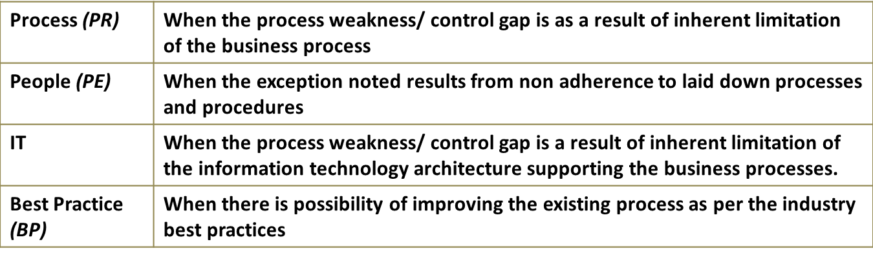
Root cause definition
53

Slide 54
Caveats
The findings of our report are based on the records and documents provided to us for verification.
Transactions and events, which are not recorded and/ or not disclosed to us, may not be identified in our review.
Internal audits are normally always undertaken on a verification of sample documents only & management needs to consider the effect of these observations on the overall population by undertaking their own analysis & verification of the population. Sampling can be defined as the process of examining only part of a set of data/population, sufficient to gain reasonable assurance regarding the entire data/population.
An IA also entails enquiries with management with the principle that relevant information to draw our observations have been provided & not deliberately withheld. An IA also involves a review of accounting & other records, certain analytical procedures & reliance on photocopies of certain documents where originals were not provided.
We have assumed genuineness of all documents and signatures thereon as if they were the originals and that, copies confirm to the originals.
We assume no obligation to update this report on any events subsequent to its issue, which may have a material effect on the validity of the information stated therein.
Our review and observations are based on Tally backup provided as on 12 October 2023.
Our review and observations are based on documents/records provided to us during audit and discussions.
Circulation: Our report has been prepared exclusively for the Company’s use and should not be quoted or referred to, in whole or in part, without our written consent. We will not accept responsibility to any other party to whom this report may be shown or who may acquire a copy of the report.
54

Slide 55
Your primary contact
Other offices (including associates) in India
RAVINDRA RAO
DHANANJAY PARCHURE
Partner, Risk Consulting
Tel: 022 6158 6200
Email: dhananjay.parchure@mazars.in;
Mumbai Office
Esplanade House
29 Hazarimal Somani Marg Mumbai-400001
Ahmedabad: 3rd Floor, Devpath Complex, Behind Lal Bungalow, Off C G Road
Bengaluru: 2nd floor, 102 Gangadhar Chetty Road, Near Ulsoor Lake
Chennai: Unit 5, 3rd Floor, Rozy Tower, Nungambakkam High Road,
Gurugram: 421 Udyog Vihar, Phase IV, Behind TCS bldg
New Delhi: C-37, Inner Circle, Connaught Place
Pune: 3rd floor, Pro 1, Business centre, Plot 34, 35, Senapati Bapat Road
55

